Slide 1

AWS - Implementing permissions guardrails across accounts

Slide 2
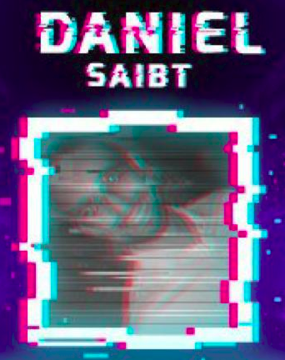
whoami
Daniel Saibt
Lead do time de segurança da vertical digital na Linx;
Vivência prática como pentester;
Focado atualmente em cloud security;
Pai da Cecília do Otto e marido da Karen;

Slide 3
Contents
Introduction and Concepts
The Challenge
Hands on with AWS Organizations / Service Control Policies
TTPs in the Cloud
Where do I start ?
Questions

Slide 4

Introduction and Concepts

Slide 5
AWS Organizations
AWS Organizations helps you centrally govern your environment as you grow and scale your workloads on AWS.
https://aws.amazon.com/organizations/
Work in two mode:
- Billing
- Full

Slide 6
AWS Organizations features
Manage and define your organization and accounts
Control access and permissions
Secure your environment for compliance
Share resources across accounts
Centrally manage costs and billing

Slide 7
Service Control Policies
[..] you can use Service Control Policies (SCPs) to set permission guardrails with the fine-grained controls used in AWS Identity and Access Management (IAM) policies. This makes it easier to meet the specific requirements of your organization’s governance rules.
https://docs.aws.amazon.com/organizations/latest/userguide/orgs_introduction.html
This is our guardrail;
Applied at account level, not user level;
JSON like;

Slide 8
The challenge

Slide 9
Multi Account Environment
You will need more and more accounts:
Production Account
Staging Account
Dev Account
Security Strategy
Cyber Security Account
Break Glass Account
Or product/team/compliance accounts:
Retail team account
Market team account
Datalake team account
PCI DSS account

Slide 10

Development Process
How to give product and development teams freedom of action?
How to balance the usability versus security?

Slide 11
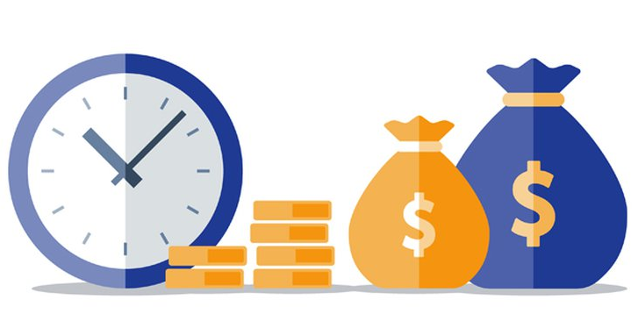
Costs control and Asset Inventory
And the cost? AWS launches new tools every time.
What about asset inventory? Do you really use all regions?

Slide 12

Incident Response and Security Baseline
What if an access key is compromised?
How to ensure that security controls have not been disabled or tampered with?

Slide 13
The basis of our defense

Slide 14

Decentralized mode
Development Account
Cyber Security
Account
Staging Account
Production Account
PCI DSS
Account

Slide 15
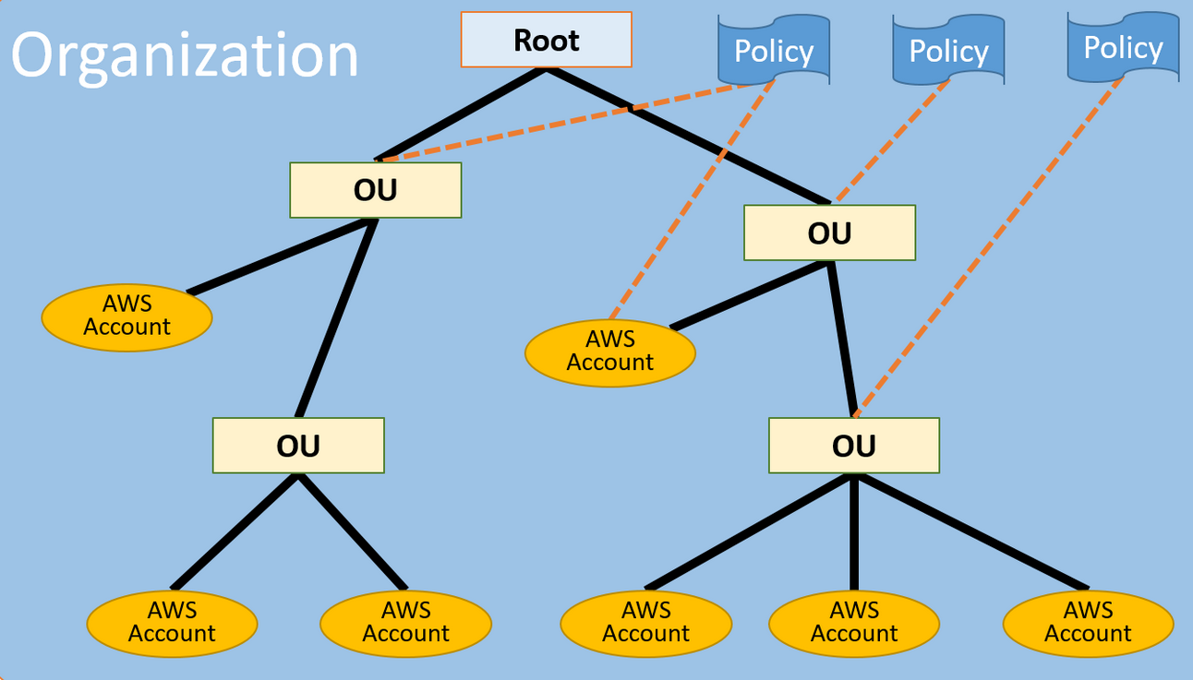
Centralized mode
https://docs.aws.amazon.com/organizations/latest/userguide/orgs_getting-started_concepts.html

Slide 16
Hands on with AWS Organizations

Slide 17
TTPs in the Cloud

Slide 18
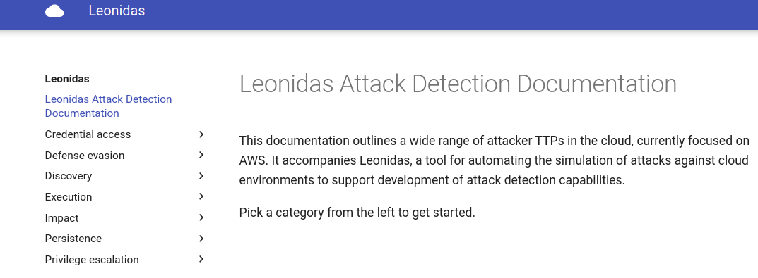
Leonidas Framework
Leonidas, a framework for executing attacker actions in the cloud...
Project:
https://github.com/FSecureLABS/leonidas
Documentation:
http://detectioninthe.cloud/
Notes:
Demonstrar ataques no CLIçç

Slide 19
Leonidas Framework
Testing the guardrails
Evading defense:
aws cloudtrail stop-logging --name production-trail
Notes:
Demonstrar ataques no CLIçç

Slide 20
Leonidas Framework
Testing the guardrails
Evading defense:
aws configservice delete-config-rule --config-rule-name s3-bucket-public-read-prohibited
Notes:
Demonstrar ataques no CLIçç

Slide 21
Leonidas Framework
Testing the guardrails
Evading defense:
aws guardduty delete-detector --detector-id aab9cebb4e538b7b9672e7a8728716d7 --region us-east-1
Notes:
Demonstrar ataques no CLIçç

Slide 22
Where do I start ?

Slide 23
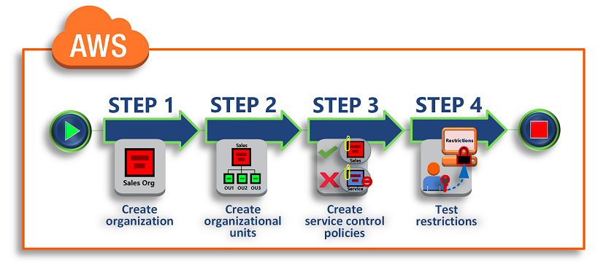
Step by step
https://docs.aws.amazon.com/organizations/latest/userguide/orgs_tutorials_basic.html
Notes:
Demonstrar ataques no CLIçç

Slide 24
Questions?

Slide 25
Contatos
Linkedin: https://www.linkedin.com/in/daniel-saibt-4b77909/
Email: danielsaibt@gmail.com
Insta: danielsaibt

